Slide 1
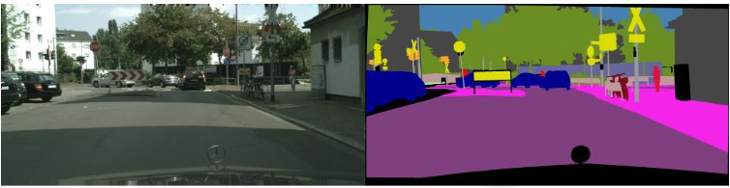
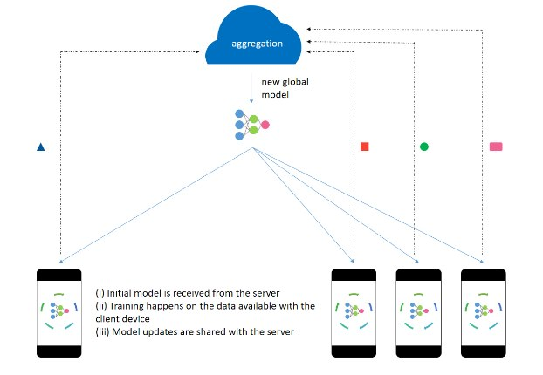
Federated Semantic Segmentation for Self-driving Cars
Gabriele Cassetta s296284 Selen Akkaya s289332 Mengdi Yang s288434

Slide 2
w
w
w
w
a) For vertical images

Slide 3
h
h
h
w
h
h
h
w

Slide 4
h
h
h
w
b) For horizantal images

Slide 5
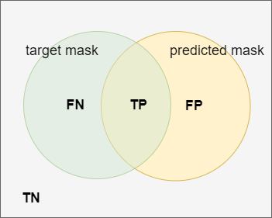
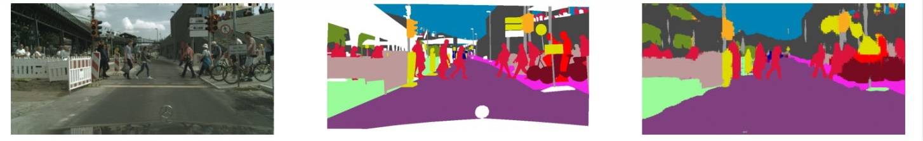
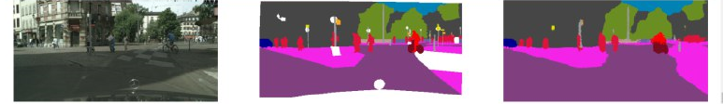
Introduction
Semantic Segmentation
Input: B x C x H x W images
Output: B x N x H x W
Common metric: mIoU
Source Image
Ground Truth
Prediction

Slide 6
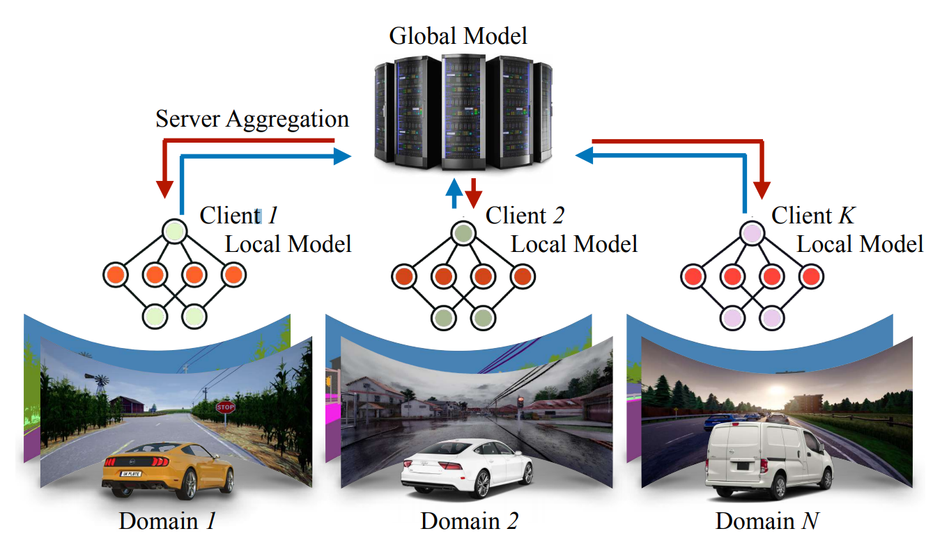
Introduction
Federated Learning
N devices train their local model → Privacy concern
Updates are sent to the server → No sensible data collected
Updates are averaged on the server
Server sends back the updated model

Slide 7
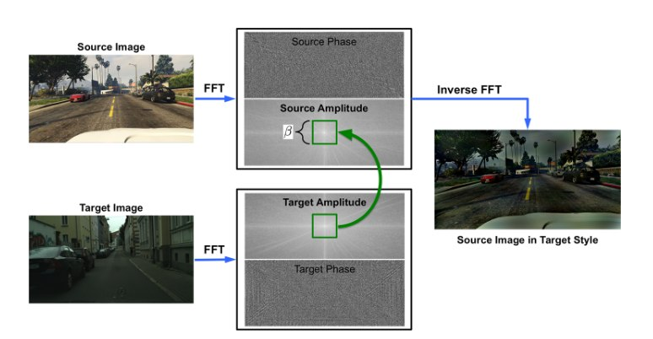
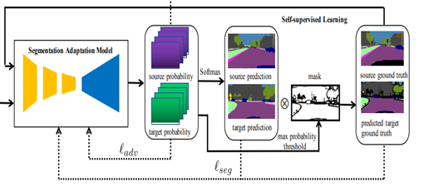
Introduction
FDA
Domain Adaptation
Dataset
Real world
PSEUDO-LABELS
Teacher model
Unlabeled target
Pseudo-label
Student model

Slide 8
Main Contribution
Centralized baseline: mIoU=42% on partition A, mIoU=30% on partition B
Federated setting: mIoU=14% on partition A heterogeneous split
Fourier domain adaptation: mIoU=17% with FDA on partition A
Federated setting with pseudo-labels: mIoU=17% with FDA-trained teacher on partition A uniform split
MobileNetv2 ( Optional ): mIoU=41% centralized, mIoU=28% federated

Slide 9
Related Works
BiSeNet V2 [1]
FedDrive [2]
FDA: Fourier Domain Adaptation [3]
LADD [5]
Pseudo-labels [4]

Slide 10
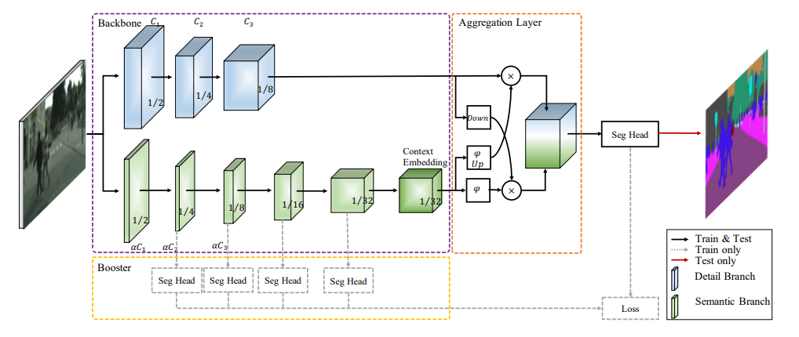
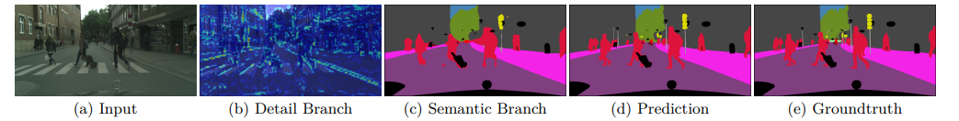
Method
Centralized baseline
BiSeNet V2[1]
CityScapes[6] dataset

Slide 11
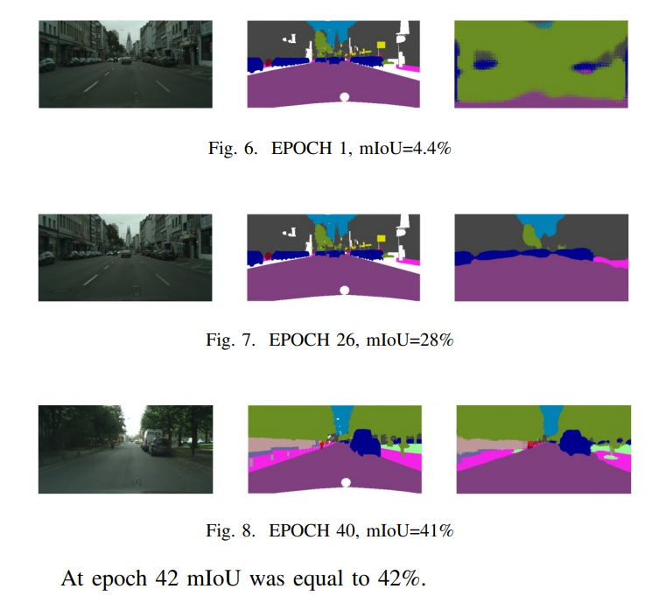
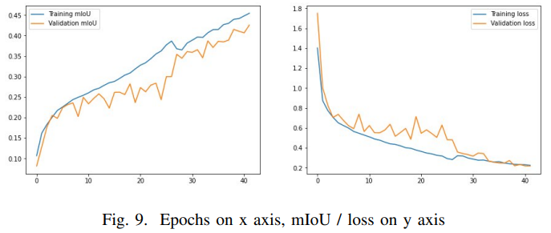
Experiment
Test set : 2 random images from each city (in total 42 images)
Train set : all the remaining ( 708 images )
Centralized baseline
Hyper-parameters :
• Batch size : 8
• Learning Rate : 0.05
• Weight Decay : 5e-5
• Number of epochs : between 20 - 80
• Resizing : 512 x 1024
Cross Entropy as loss
SGD as the optimizer
mIoU as a validation metric.
Partition A

Slide 12
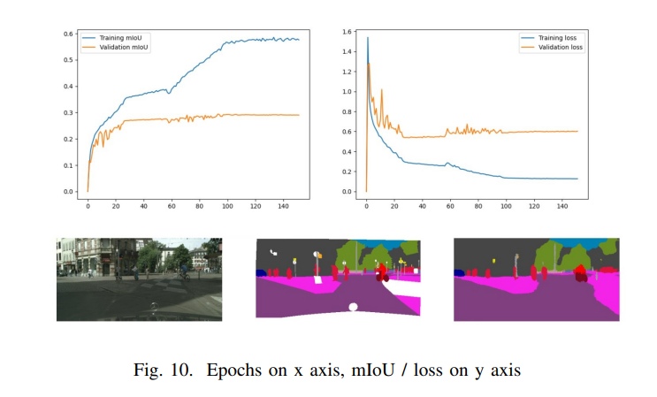
Experiment
Centralized baseline
Partition B
Train set : 500 images
Test set: 250 images

Slide 13
Method
Federated Setting
_{FedAvg algorithm}
Data Splits
Heterogeneous: each client → 1 city
Uniform: each client → multiple cities

Slide 14
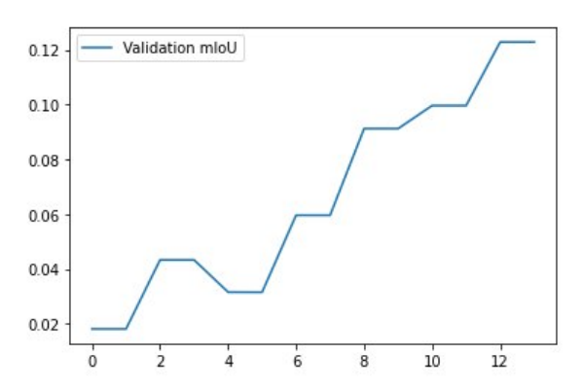
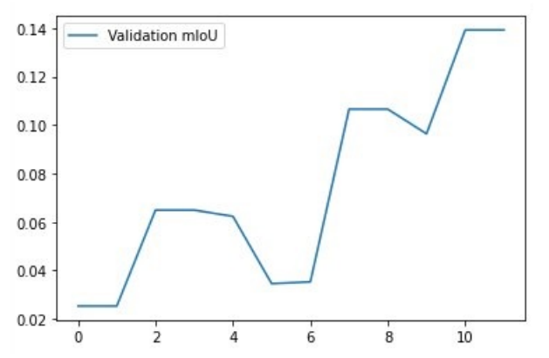
Experiment
Hyperparameters:
Batch size : 4
Learning Rate : 0.05
Weight Decay : 5e-5
Size : 512 x 1024
Epochs per client: 10-12
Rounds: 8
Clients selected: 10/tot
Images per client: <20
Partition A uniform
Partition A heterogeneous

Slide 15
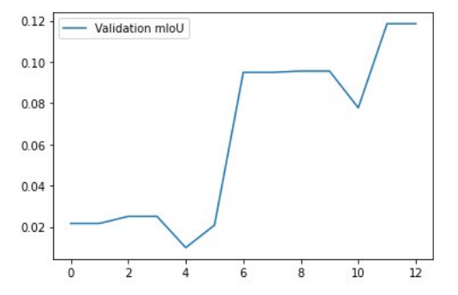
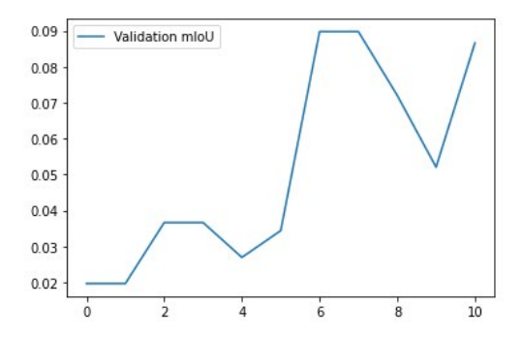
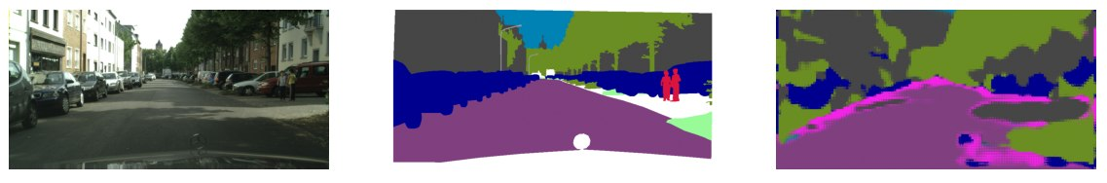
Experiment
Partition B uniform
Partition B heterogeneous

Slide 16
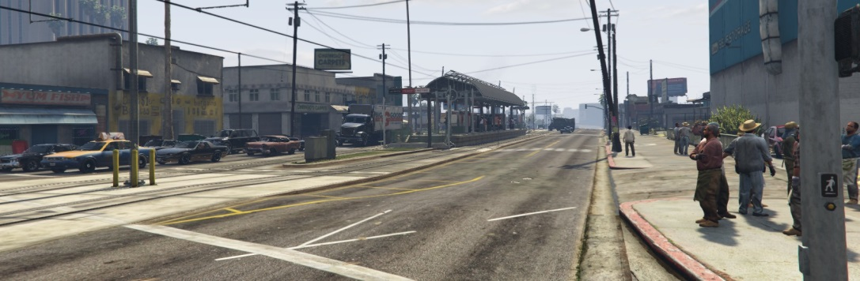
Method
Domain Adaptation
More practical scenario
GTA5[7] dataset
Fourier
Domain Adaptation
GTA5 Dataset
Real world
(Cityscapes)

Slide 17
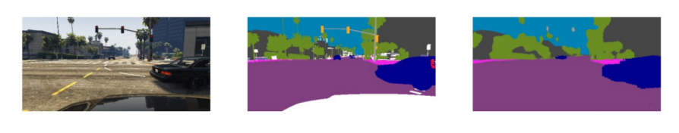
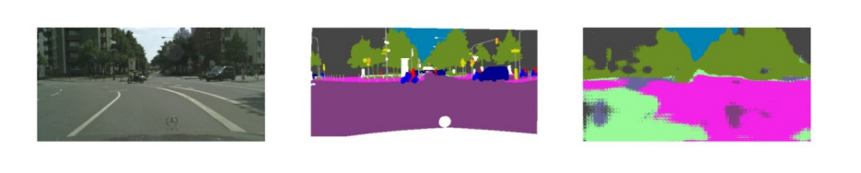
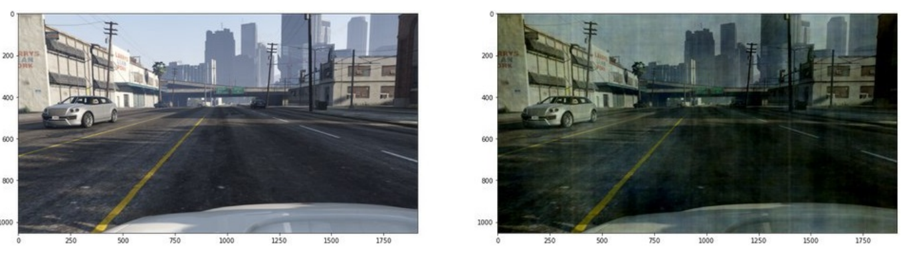
Experiment
Training on GTA5 – Testing on GTA5
Ground truth
prediction
Training on GTA5 – Testing on Cityscapes
Ground truth
prediction
_{mIoU=13%}
FDA
GTA5 image transformed with the average style from a random city in Cityscapes
L = 0.01

Slide 18
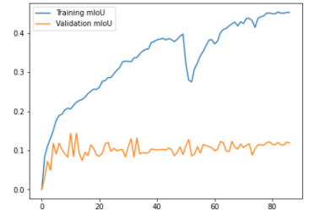
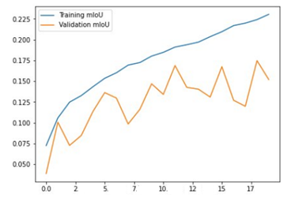
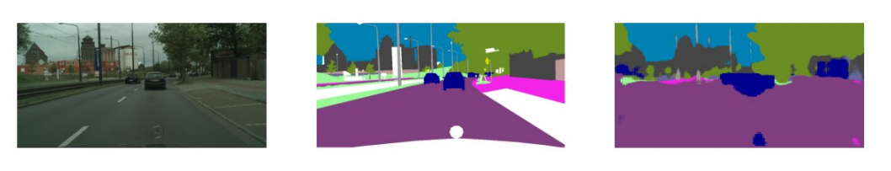
Experiment
trained on GTA5, tested on Cityscapes
No FDA
FDA, L=0.01
Prediction on Cityscapes, model trained on FDA-transformed GTA5 images

Slide 19
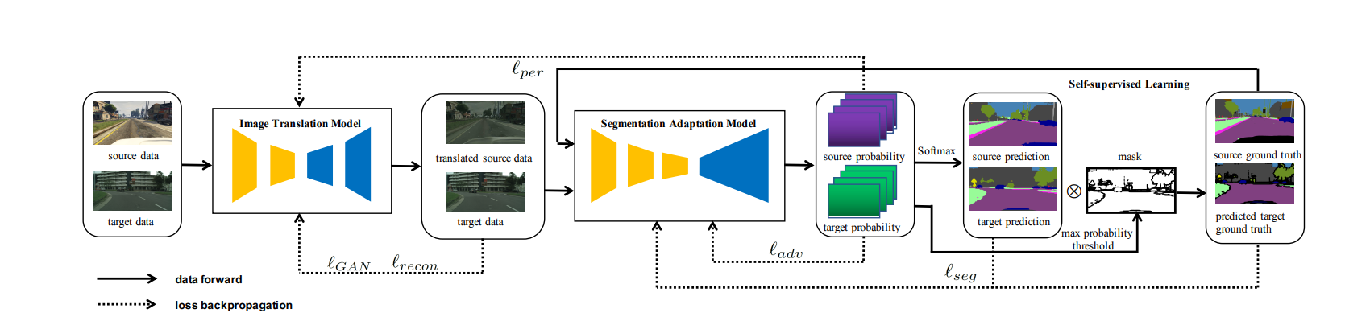
Method
Considering a real-world scenario
Federated Self-Training Using Pseudo-Labels
Teacher Model
Student Model

Slide 20
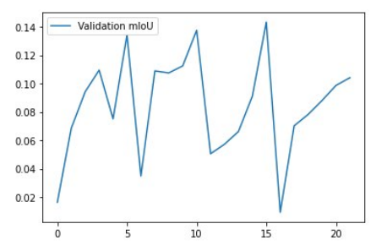
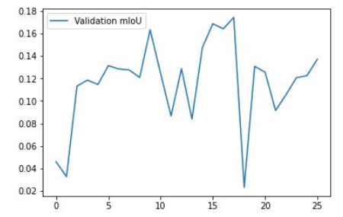
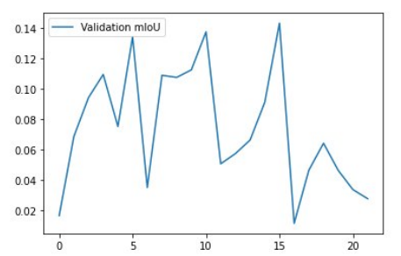
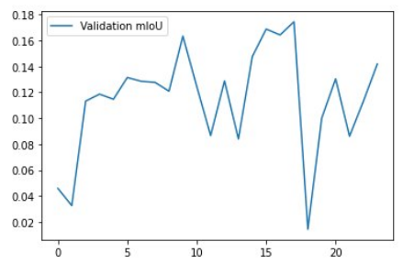
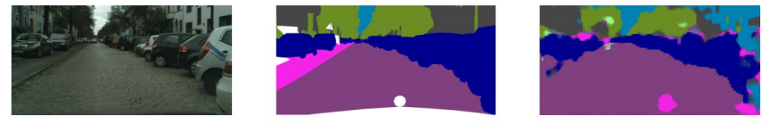
Experiment
FDA
no FDA
partition A heterogeneous
FedAvg Training
Using Pseudo-labels
Teacher Model Never Updated
partition A uniform
FDA, mIoU=17%

Slide 21
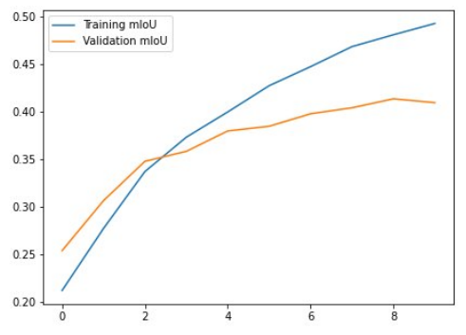
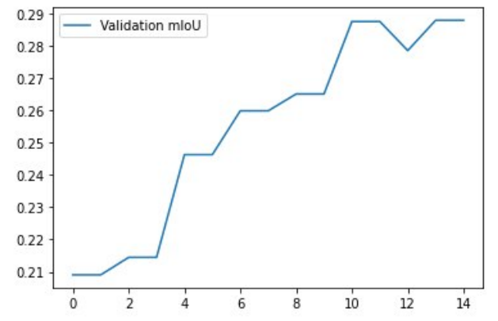
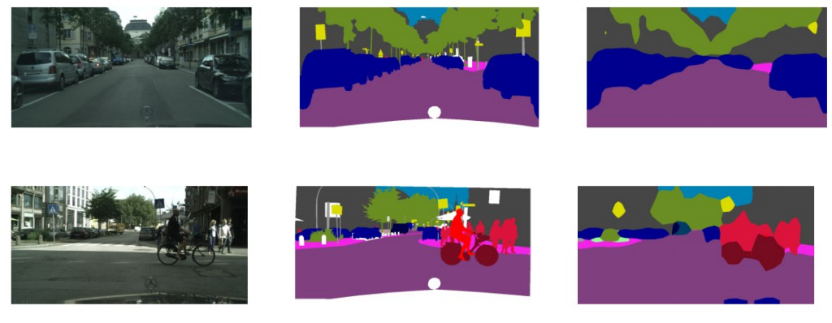
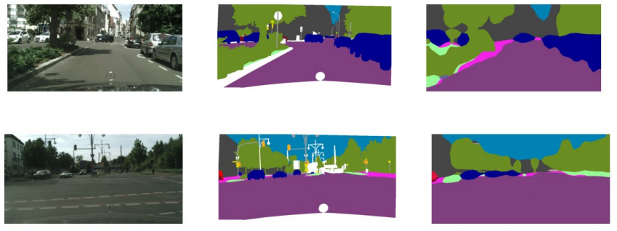
Method (Optional)
Consideration of MobileNetV2 with a Deeplab V3 head
Centralized Baseline
Federated Setting
best predictions val-mIoU : %41 after 10 EPOCHS
best predictions val-mIoU : %28 after 14 ROUNDS
Politecnico di Torino – Course of Advanced Machine Learning

Slide 22
CONCLUSION
Centralized vs Federated
mIoU=42% mIoU=14%
Trained on GTA5 tested on Cityscapes
Federated setting with pseudo-labels
MobileNetv2 - DeepLab V3 : Centralized vs Federated
mIoU=13%
Improvement by FDA
mIoU=17%
Pre-trained model with FDA
mIoU=17%
mIoU=41%
mIoU=28%
Politecnico di Torino – Course of Advanced Machine Learning

Slide 23
[1] C. Yu, C. Gao, J. Wang, G. Yu, C. Shen, and N. Sang, “Bisenet V2: bilateral network with guided aggregation for real-time semantic segmentation,” CoRR, vol. abs/2004.02147, 2020.
[2] Fantauzzo, Lidia, et al. ”FedDrive: generalizing federated learning to semantic segmentation in autonomous driving.” 2022 IEEE/RSJ International Conference on Intelligent Robots and Systems (IROS). IEEE, 2022.
[3] Yang, Yanchao, and Stefano Soatto. ”Fda: Fourier domain adaptation for semantic segmentation.” Proceedings of the IEEE/CVF Conference on Computer Vision and Pattern Recognition. 2020.
[4] Li, Yunsheng, Lu Yuan, and Nuno Vasconcelos. ”Bidirectional learning for domain adaptation of semantic segmentation.” Proceedings of the IEEE/CVF Conference on Computer Vision and Pattern Recognition. 2019.
[5] Shenaj, Donald, et al. ”Learning across domains and devices: Styledriven source-free domain adaptation in clustered federated learning.” Proceedings of the IEEE/CVF Winter Conference on Applications of Computer Vision. 2023.
[6] Cordts, Marius, et al. ”The cityscapes dataset for semantic urban scene understanding.” Proceedings of the IEEE conference on computer vision and pattern recognition. 2016.
[7] Richter, Stephan R., et al. ”Playing for data: Ground truth from computer games.” Computer Vision–ECCV 2016: 14th European Conference, Amsterdam, The Netherlands, October 11-14, 2016, Proceedings, Part II 14. Springer International Publishing, 2016.

Slide 24
Thank you for your attention

